Slide 1
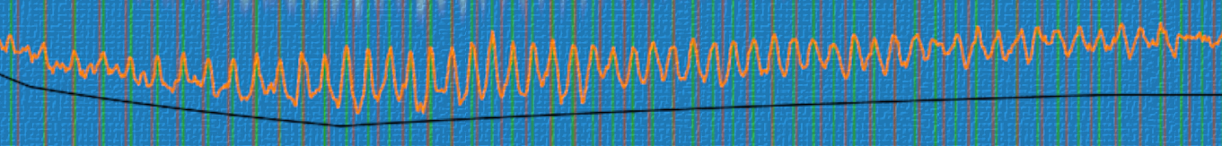
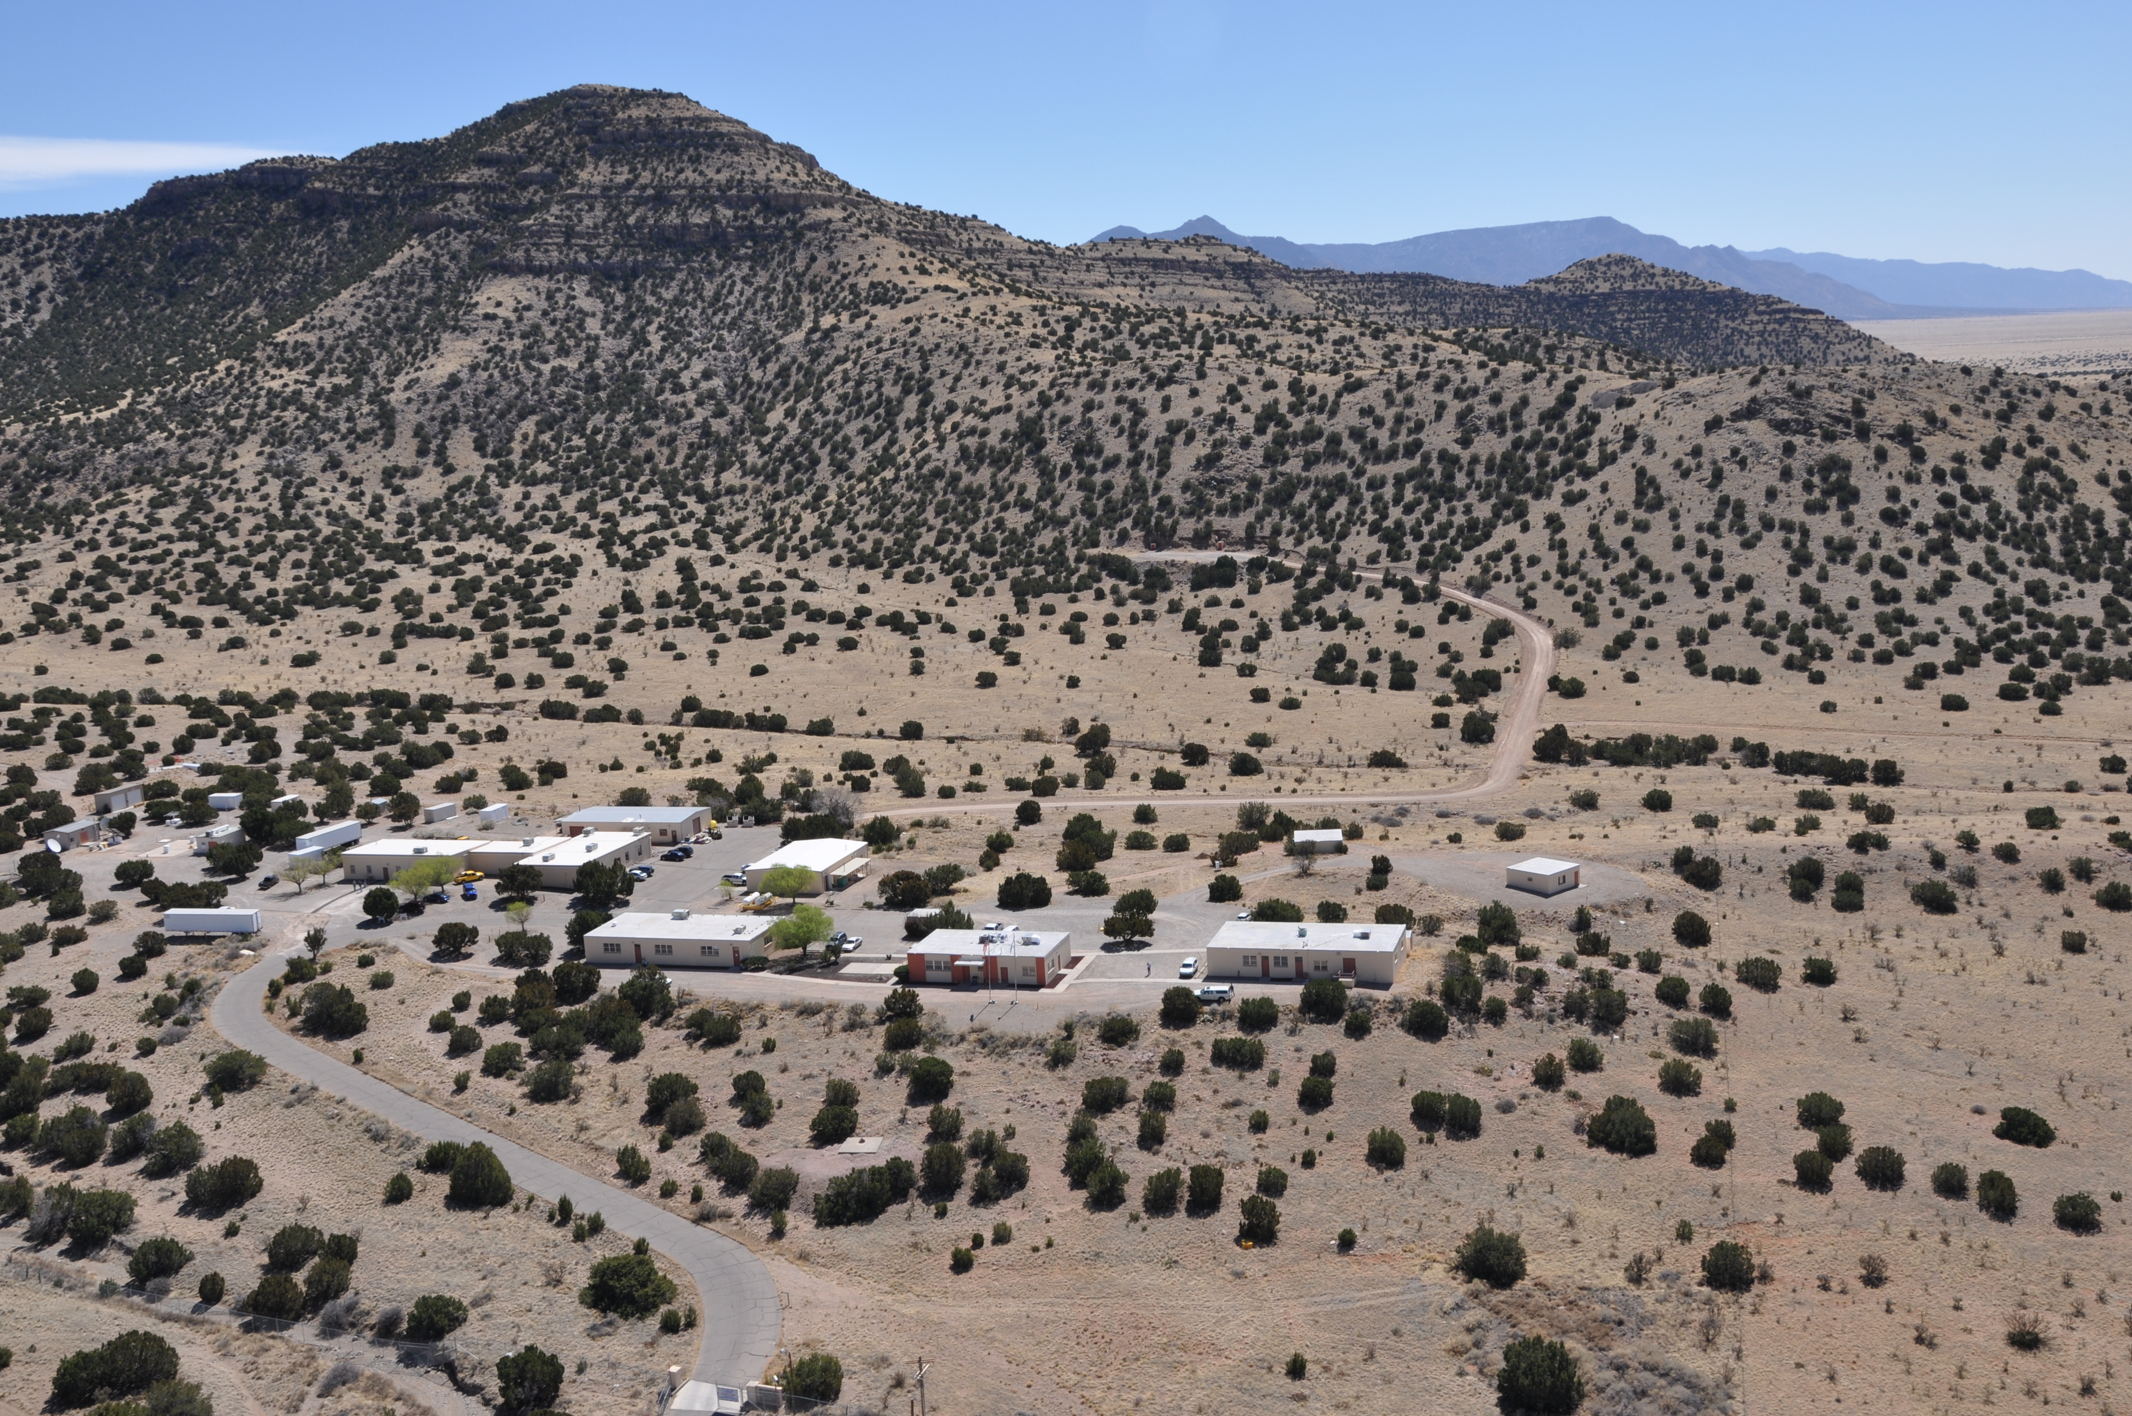

Observing the Earth through Instrumentation
Adam Ringler aringler@usgs.gov

Slide 2
Review of Seismic Data
Seismometer records ground motion and outputs a voltage
Digitizer takes in voltage and outputs time dependent counts
IRIS DMC collects the data and sends it to users in miniSEED
User downloads ground motion convolved with the instrument response and digitizer contribution

Slide 3
Review of Harmonic Representation
Every suitable signal (noise) can be represented as a sum of sines and cosines
The equation doesn’t matter. All we care about are the amplitudes and their associated frequencies

Slide 4
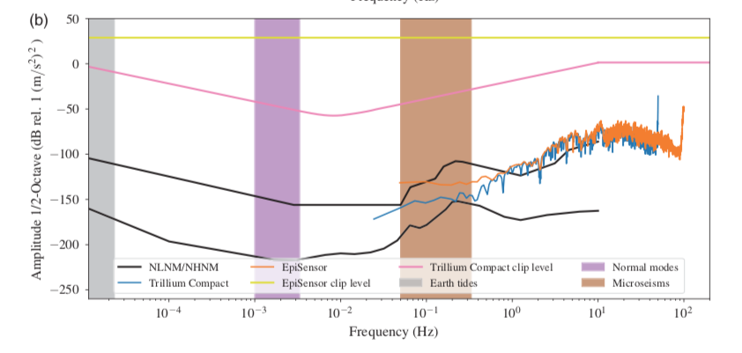
Frequency Domain
Amplitudes
The equation doesn’t matter. All we care about are the amplitudes and their associated frequencies
Frequencies
Ringler and Bastien (2020)

Slide 5
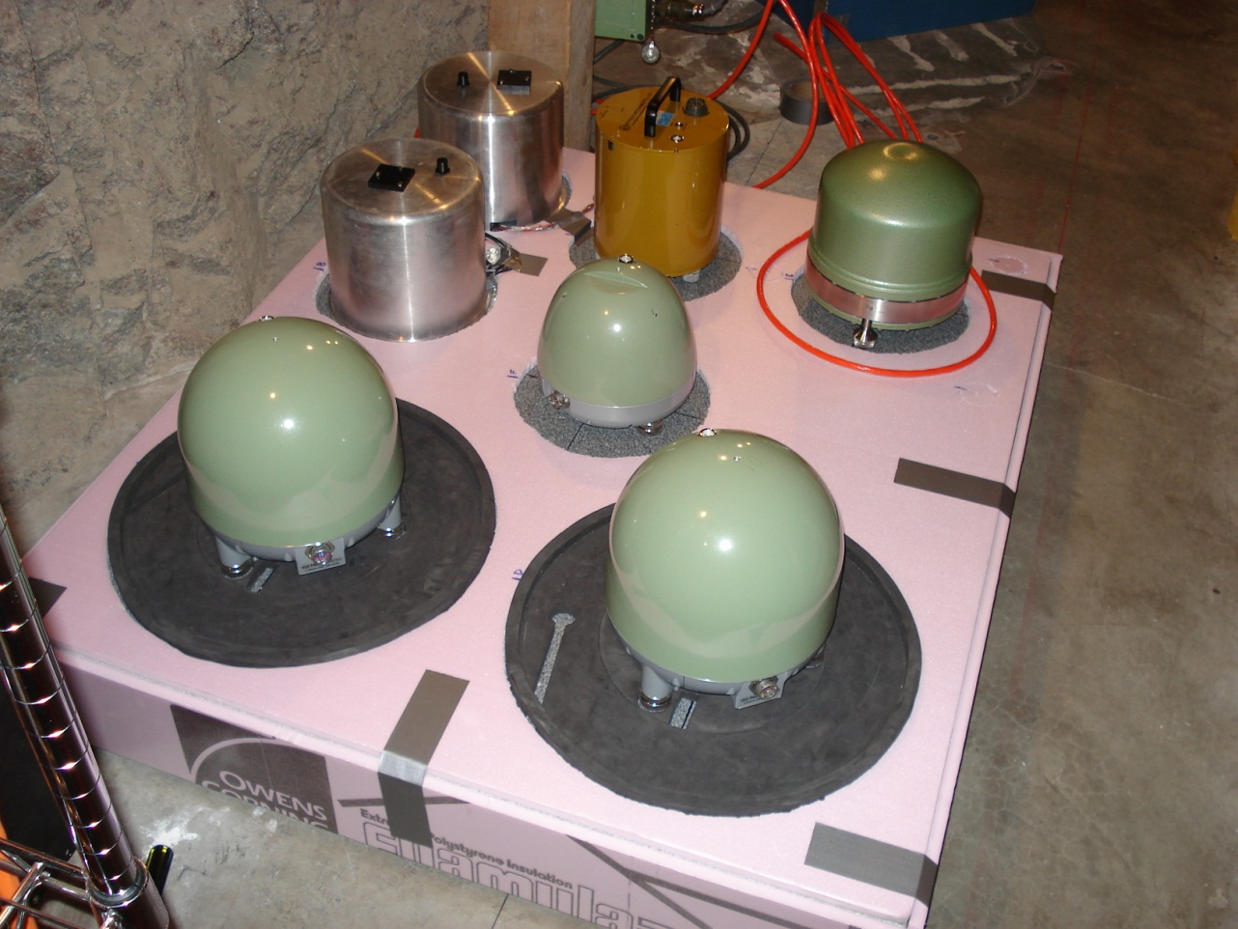
Self-Noise
So that instruments record common signals we put them on a granite slab and try to isolate them from non-seismic noise sources
STS-1 Horizontal
KS-2000
STS-2
T-120
T-240
What is the intrinsic noise of an instrument in the absence of ground motion?

Slide 6
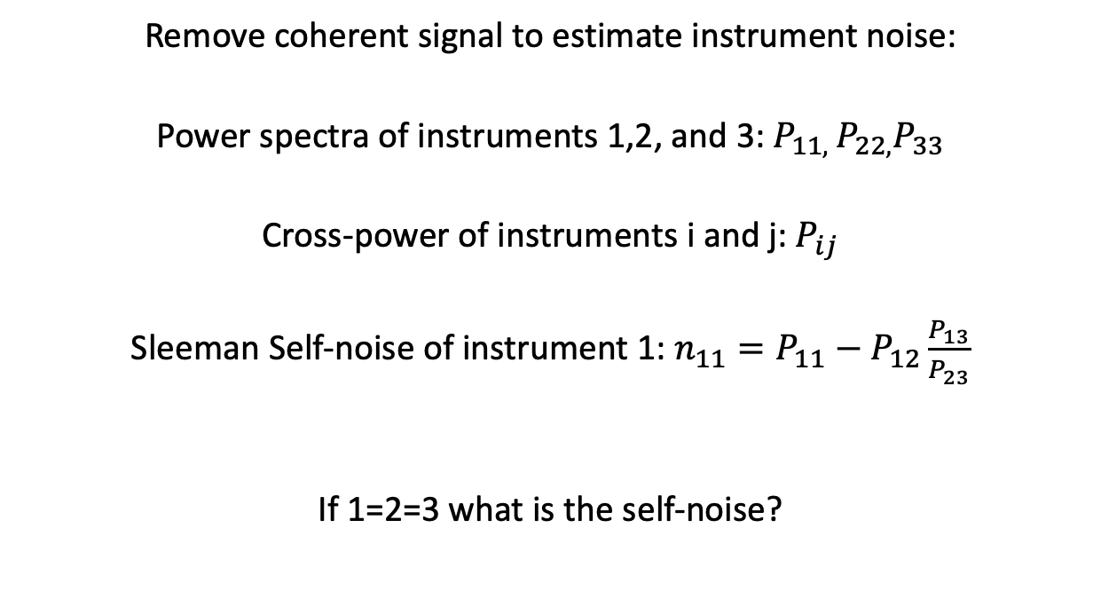
Sleeman Method
Remove coherent signal to estimate instrument noise:
Power spectra of instruments 1,2, and 3: $P_{11, }P_{22,}P_{33}$
Cross-power of instruments i and j: $P_{ij}$
Sleeman Self-noise of instrument 1: $n_{11}=P_{11}−P_{12}\frac{P_{13}}{P_{23}}$
If 1=2=3 what is the self-noise?

Slide 7
Examples of Self-Noise
If I want to record 100 s period signals which instruments will always work?
Ringler and Hutt (2011)

Slide 8
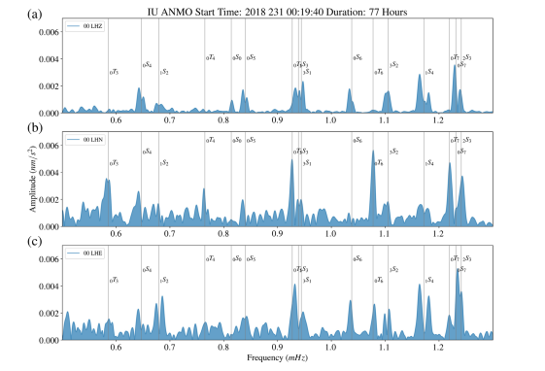
Why Do We Care?
By measuring splitting of modes (from rotation and ellipticity) we can infer structure of the Earth.
Modes give us velocity + density
P and S only give velocity

Slide 9
Sensitivity
Intrinsic sensitivity of the instrument e.g. 1500 V/m/s
Minimum resolvable signal (self-noise)
Sensitivity to non-seismic signals (temperature, pressure, other)

Slide 10
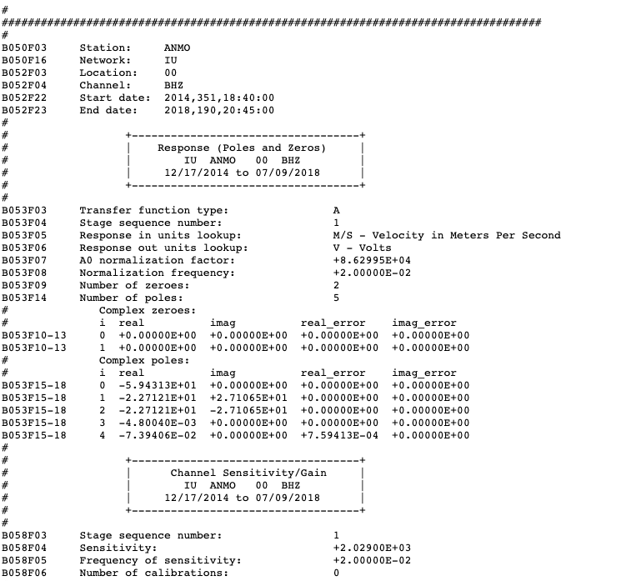
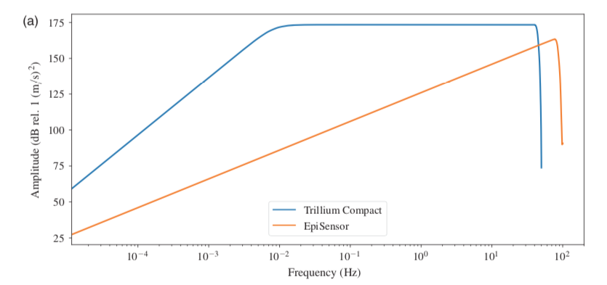
Electrical Sensitivity
The voltage the sensor puts out for a given input in the flat portion of the sensor

Slide 11
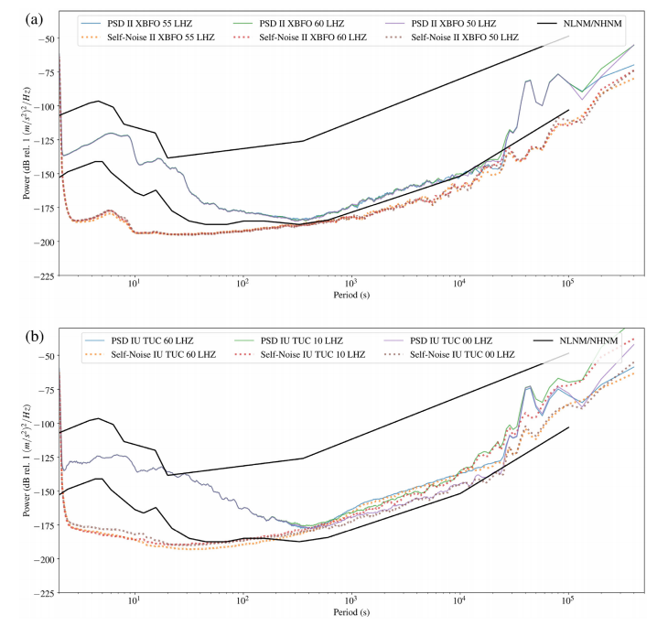
Minimum Resolution
Just the self-noise
Top at BFO
Bottom at TUC
Why do the self-noise estimates differ?
Ringler et al. (2020)

Slide 12
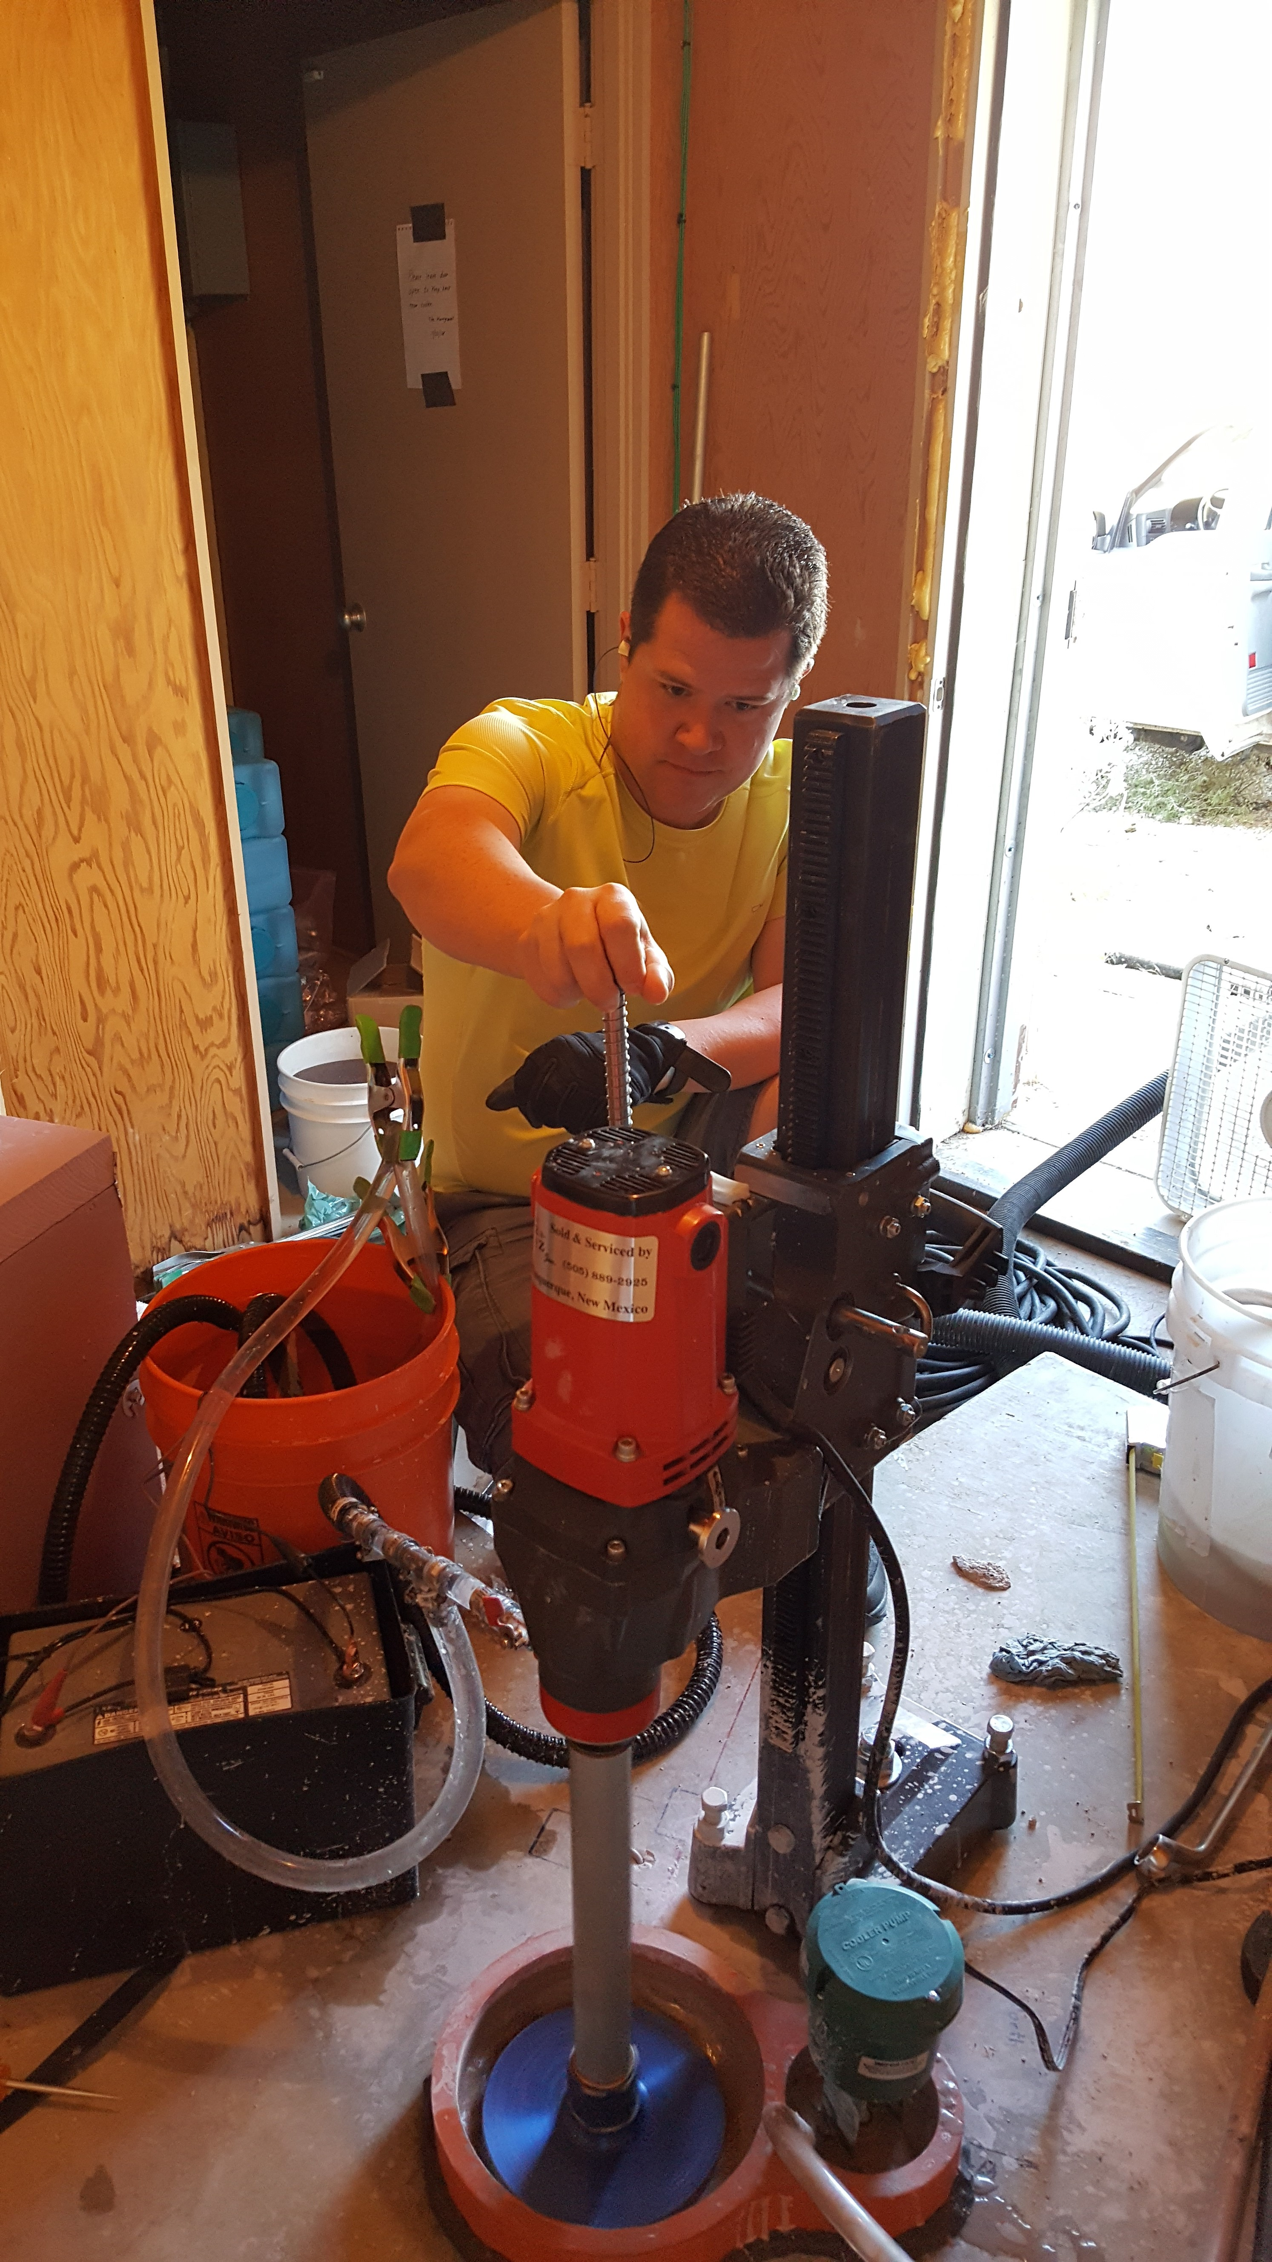
BFO versus TUC
BFO has a large amount of overburden in granite
TUC a hut on the side of the hill

Slide 13
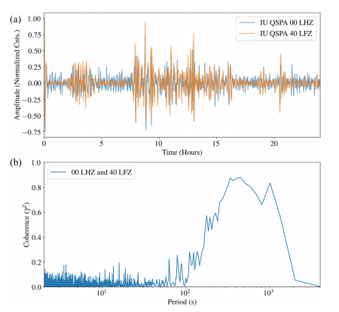
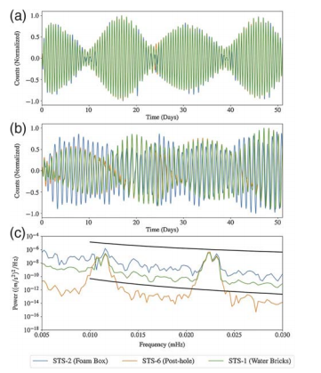
Non-seismic Noise
Magnetic (Ringler et al., 2020)
Thermal noise (Doody et al., 2017)

Slide 14
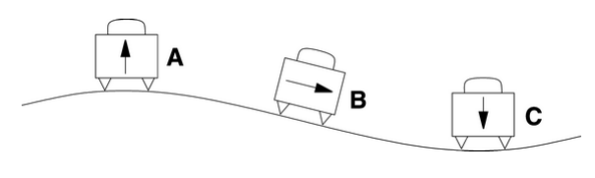
Tilt
Why is horizontal data so different?
Wielandt (2002)

Slide 15
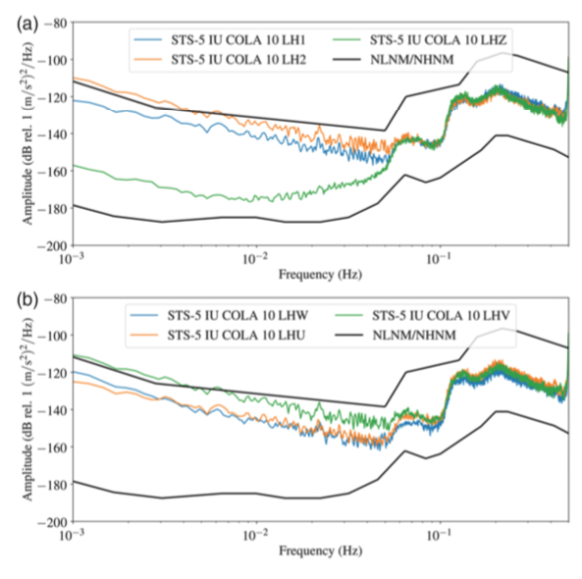
Tilt
Vertical doesn’t see tilt
In U,V,W orientation

Slide 16
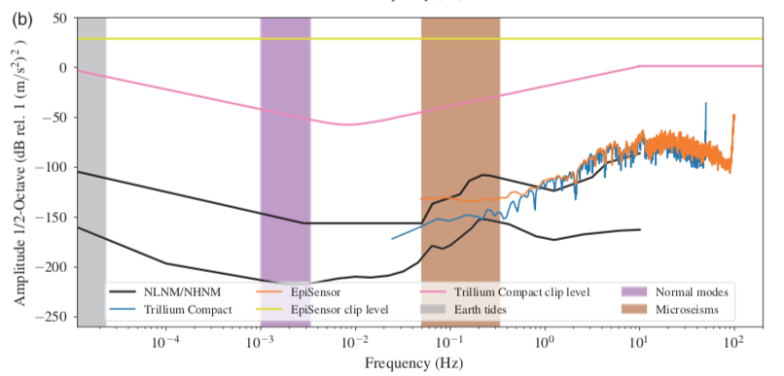
Dynamic Range
Dynamic Range = Clip-Level + minimum resolvable signal

Slide 17
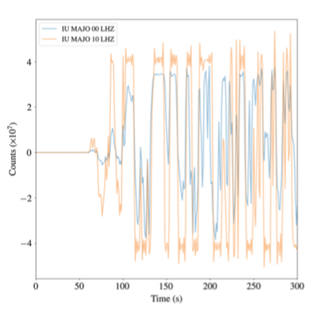
Clip Level
Most digitizers are +/-20 V so the clip level is when the sensor is outputting 20V
Clipping at MAJO from the M9 event in Japan, 2011.
Ringler and Bastien (2020)

Slide 18
Expression of Dynamic Range
Amplitude² = Power
Describe using dB
10log₁₀(Power)=20log₁₀(Amplitude)
Seismology is interested in 144 dB of dynamic range
This is equivalent of a ruler across the U.S. every 9 inches

Slide 19
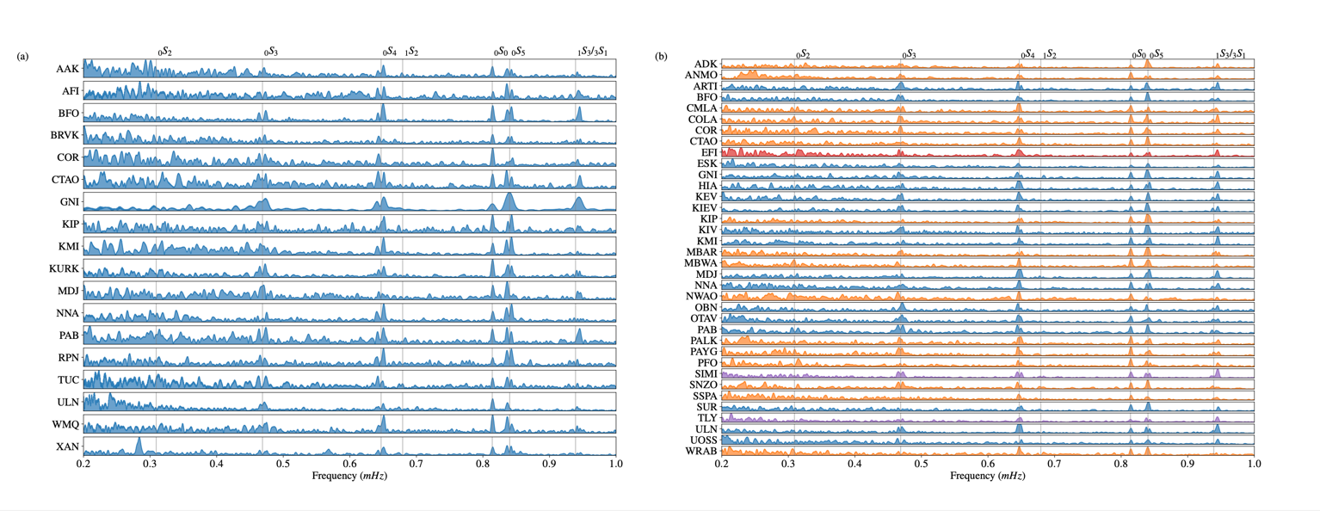
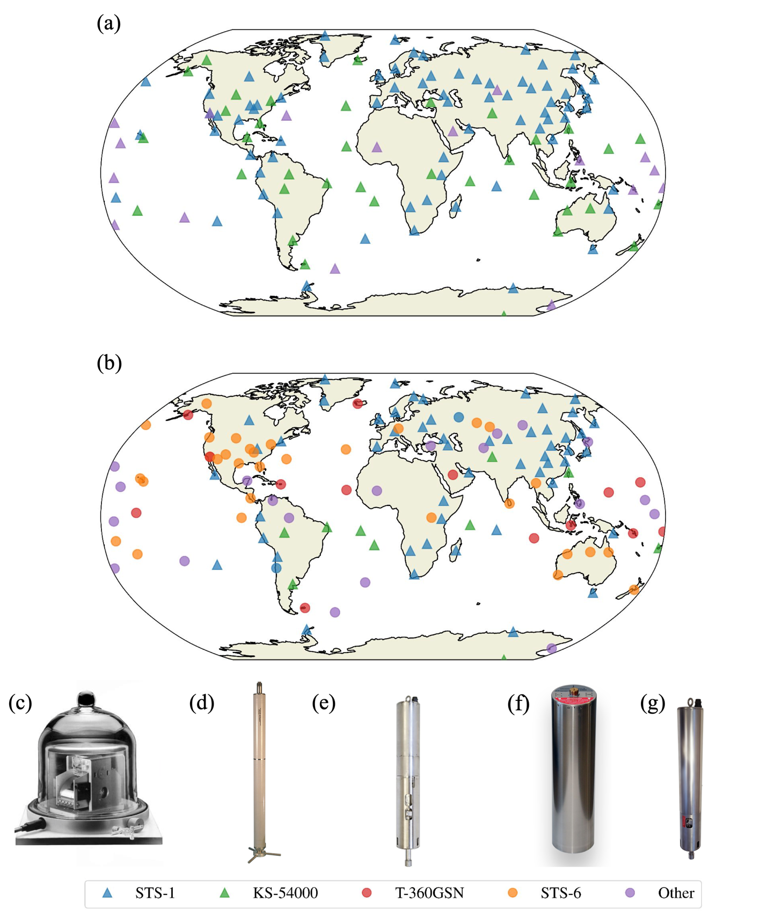
New Stuff
Replacing KS-54000 with STS-6 and T-360 improves the number of sub-1 mHz spectra by a factor of 2!

Slide 20
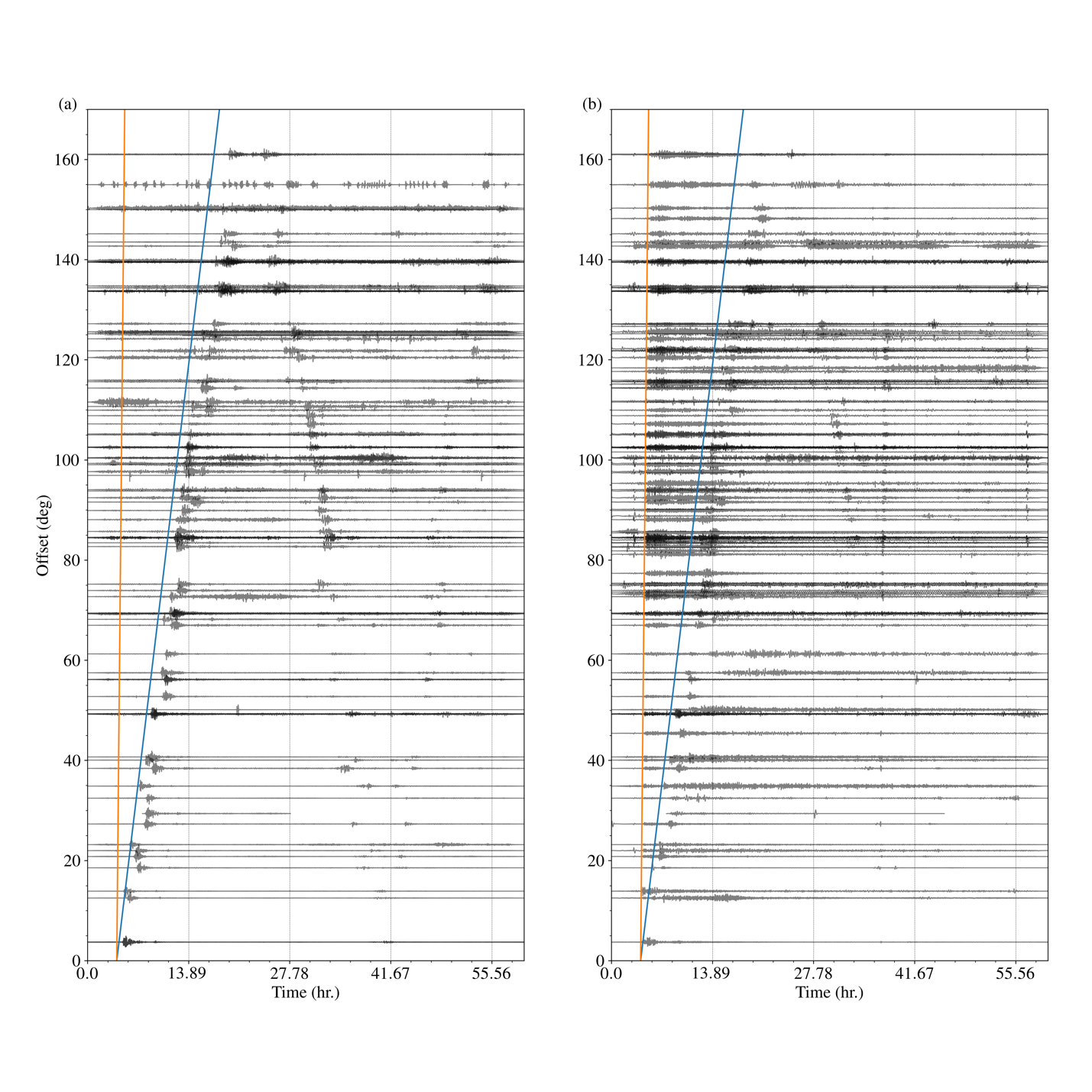
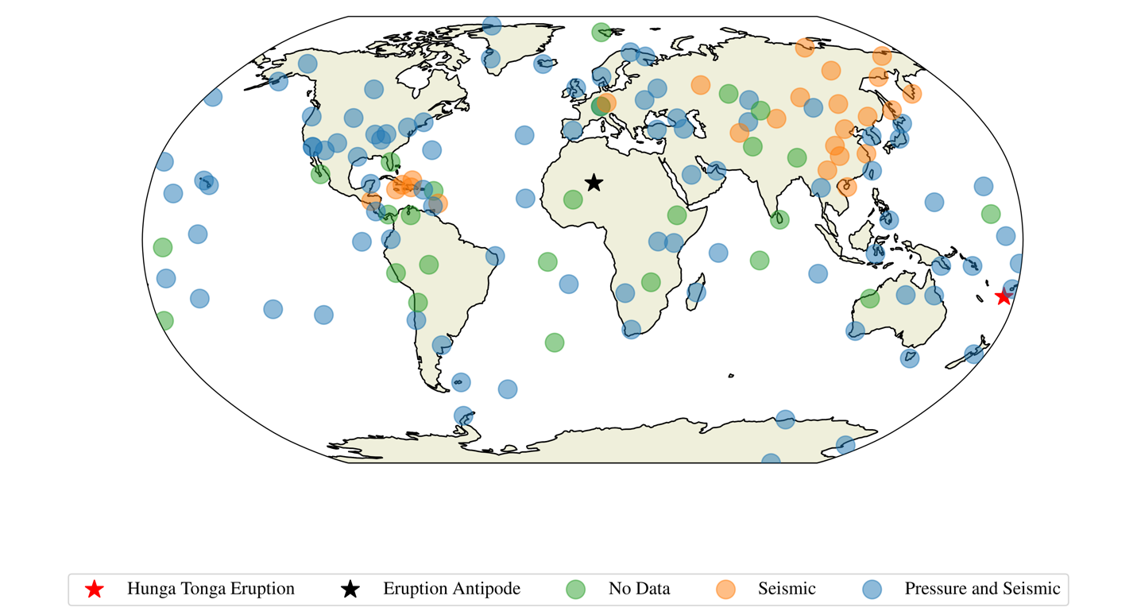
Tonga
Pressures
Seismics
Recorded globally across the GSN on pressure sensors and seismic

Slide 21
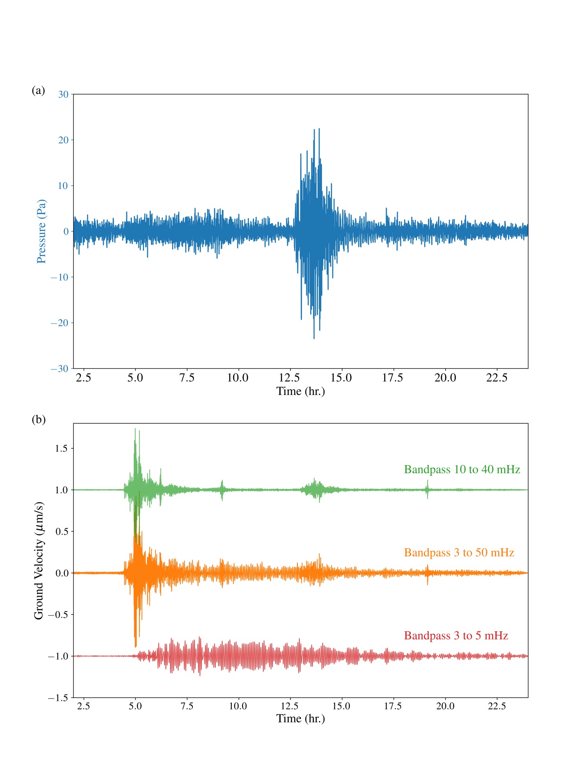
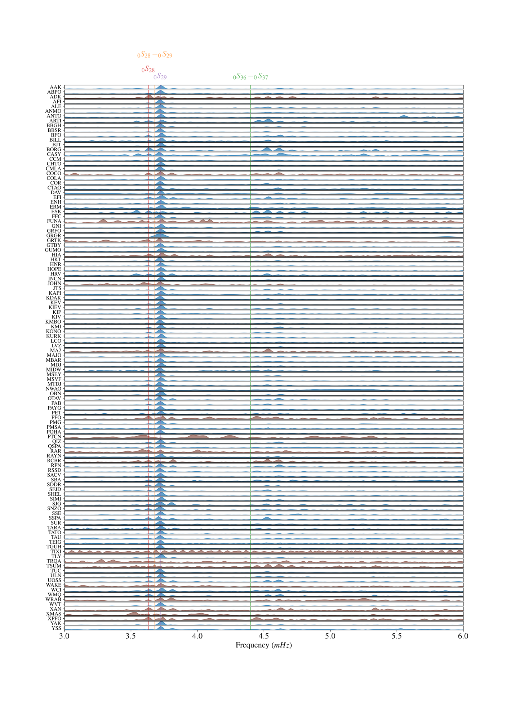
Tonga
Volcano produced atmospheric excitation at 3.7 and 4.4 mHz

Slide 22
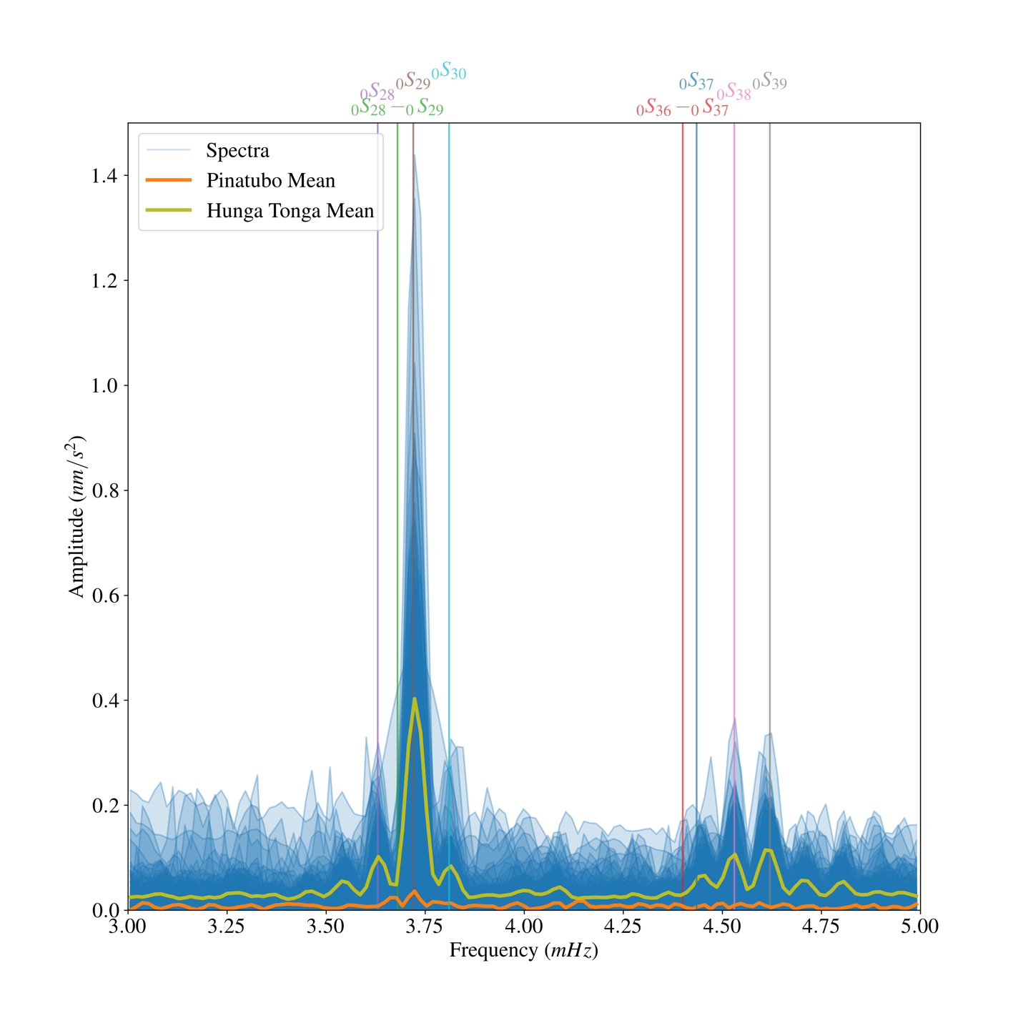
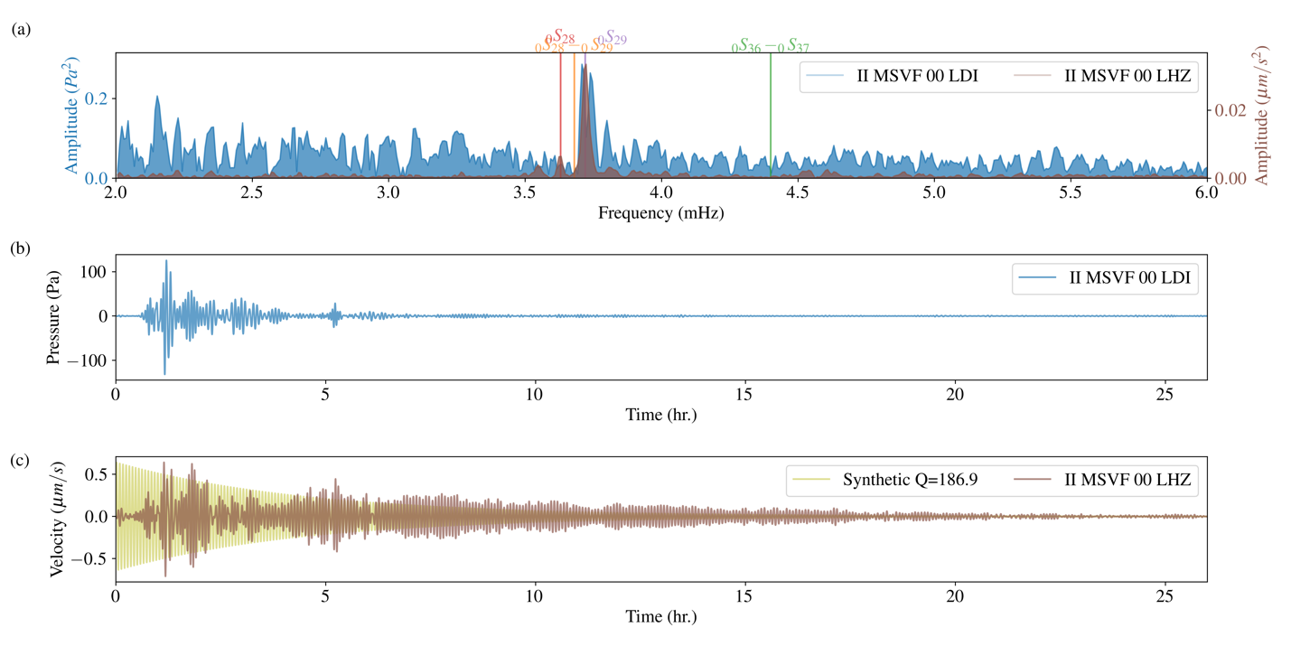
Tonga
Volcano produces atmospheric excitation
This couples into the ground and excites the 3.7 and 4.4 mHz normal modes
Requires good data and pressure recordings

Slide 23
References
Ringler and Bastien (2020). A brief introduction to seismic instrumentation: Where does my data come from?, Seismological Research Letters, in press.
Steim (2015). Theory and Observations – Instrumentation for Global and Regional Seismology.
Most papers on instrumentation can be found in the references of Steim.

